Slide 1
Finance & Risk Analytics
- Kamal H. Thampi

Slide 2
Agenda
Introduction
Overview
Sector-wise Analysis
Key Findings
Portfolio Analysis
Methodology

Slide 3
Introduction

Slide 4

Objective
We have two investors with distinct financial objectives and risk tolerance levels.
As the portfolio manager, our responsibility is to provide personalized consultation and investment advice tailored to each investor's needs and goals.
Mr. Patrick Jyenger
A conservative investor seeking to invest $500K in stocks , prioritizing low risk. His goal is to double his capital within a 5-year timeframe.
Mr. Peter Jyenger
A high-risk investor looking to invest $1 million in equities, aiming for higher returns. His objective is also to double his capital within a 5-year period.

Slide 5
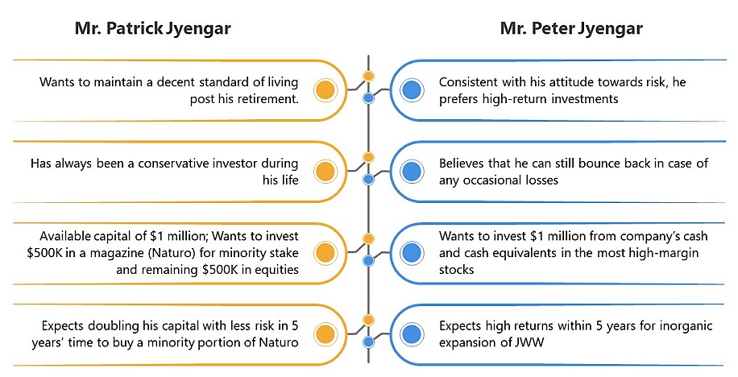
Investor Profiles

Slide 6
Overview

Slide 7
Stocks Data
Ticker | Industry | Company Name
AAL | Aviation | American Airlines Group Inc
ALGT | Aviation | Allegiant Travel Company
ALK | Aviation | Alaska Air Group Inc
DAL | Aviation | Delta Air Lines Inc
HA | Aviation | Hawaiian Holdings Inc
LUV | Aviation | Southwest Airlines Co
BCS | Finance | Barclays
CS | Finance | Credit Suisse
DB | Finance | Deutsche Bank
GS | Finance | Goldman Sachs
MS | Finance | Morgan Stanley
WFC | Finance | Wells Fargo
JNJ | Healthcare | Johnson & Johnson
MRK | Healthcare | Merck and CO inc.
PFE | Healthcare | Pfizer inc
UNH | Healthcare | United Health Group Inc
BHC | Pharmaceuticals | Bausch Health Companies inc
RHHBY | Pharmaceuticals | Roche Holding AG
AAPL | Technology | Apple Inc
AMZN | Technology | Amazon
FB | Technology | Facebook
GOOG | Technology | Alphabet
IBM | Technology | IBM
MSFT | Technology | Microsoft
24 stocks across various domains
Technology
Aviation
Financial Services
Pharmaceuticals/Healthcare
Data points
Date
Open price (start of the day)
Close price (end of the day)
High price (highest reached during the day)
Low price (lowest reached during the day)
Adjusted close price (including dividends)
Volume traded (number of stocks traded)
Duration
October 1, 2010 to September 30, 2020

Slide 8
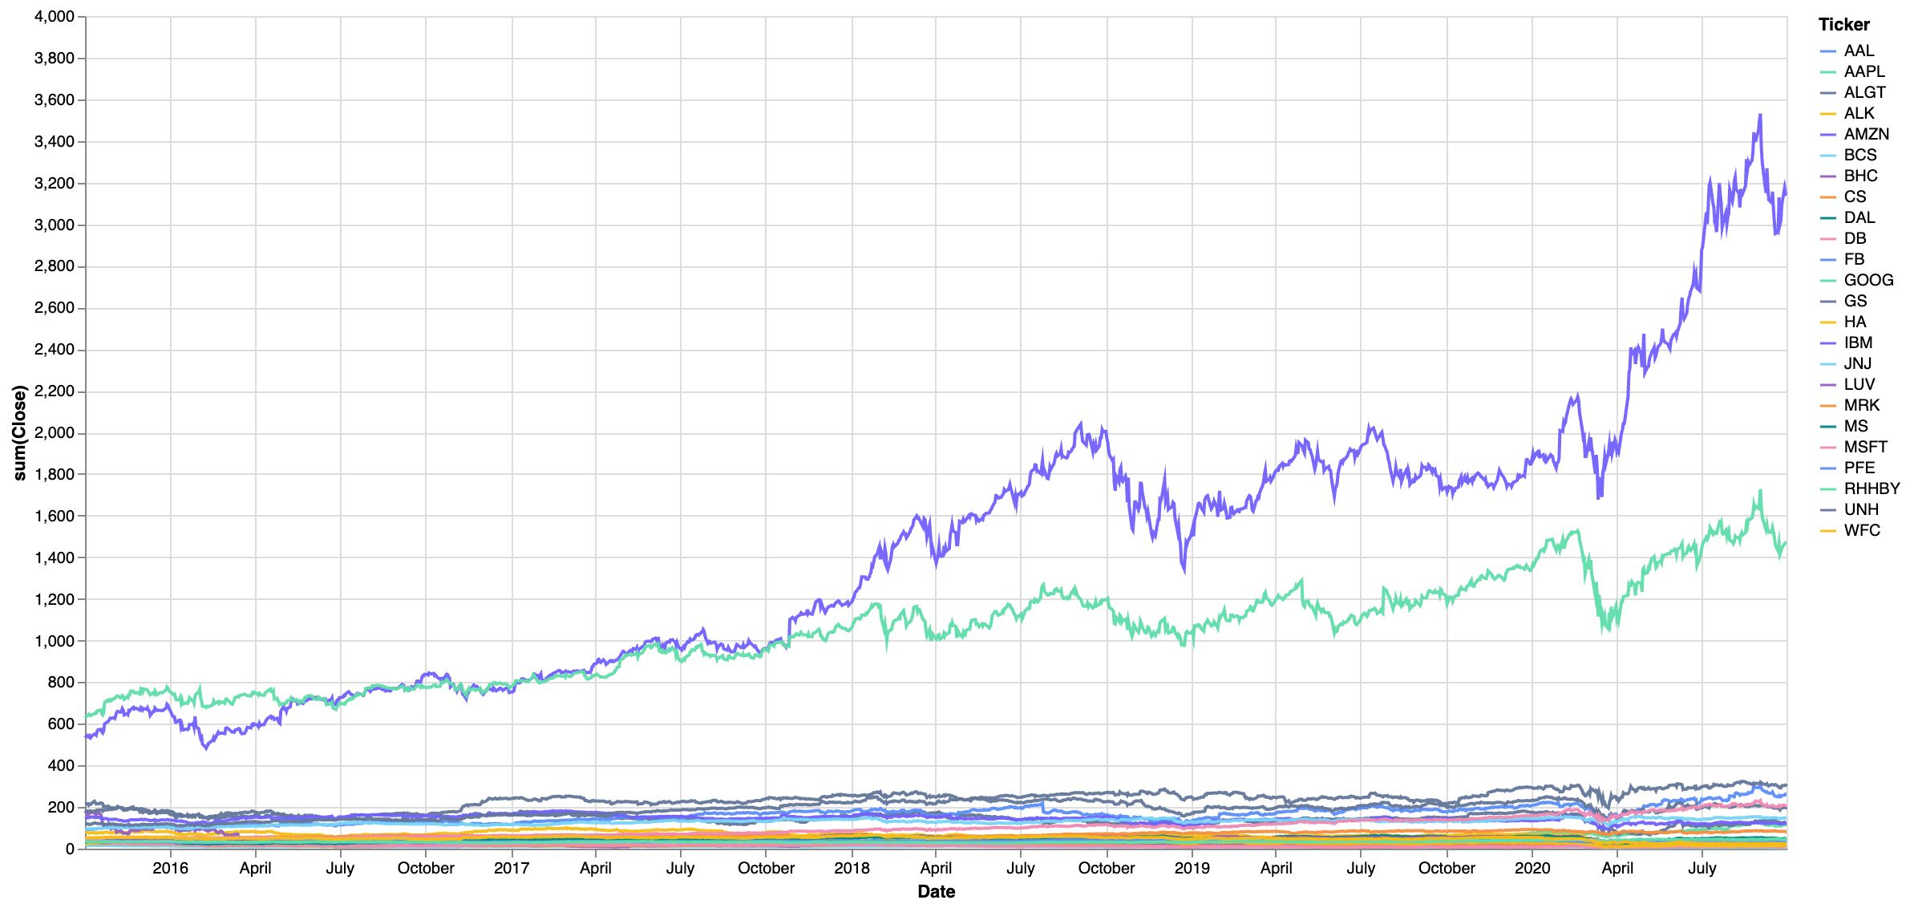
Stocks Performance (over last 5 years)
In the last 5 years, Amazon & Google have outperformed other stocks.

Slide 9
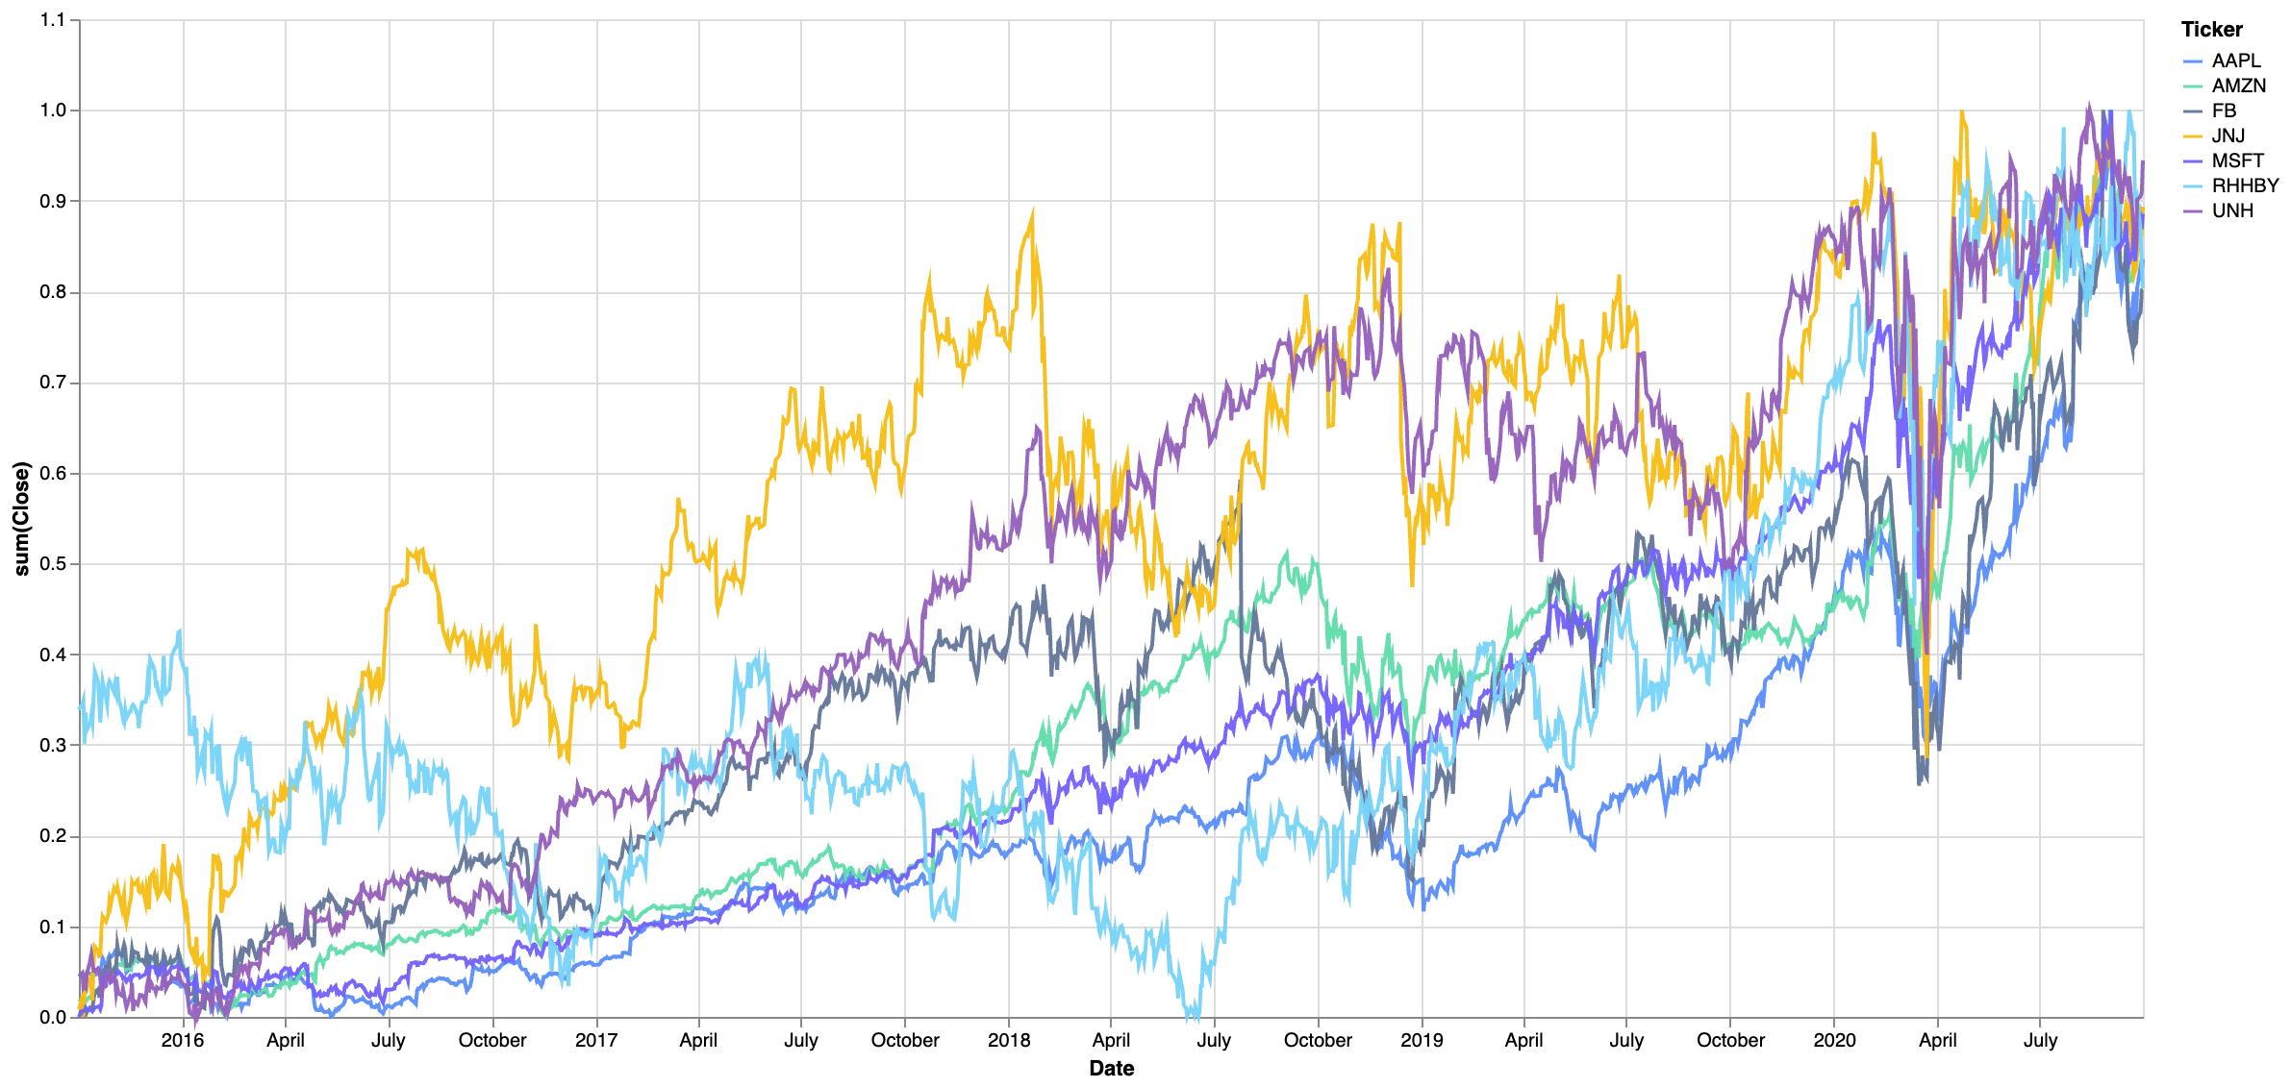
Stocks Performance (normalized data) - I
With normalized data, Apple, Amazon, Facebook, Johnson & Johnson, Microsoft, Roche Holding AG and United Health Group Inc have shown above 80% performance.

Slide 10
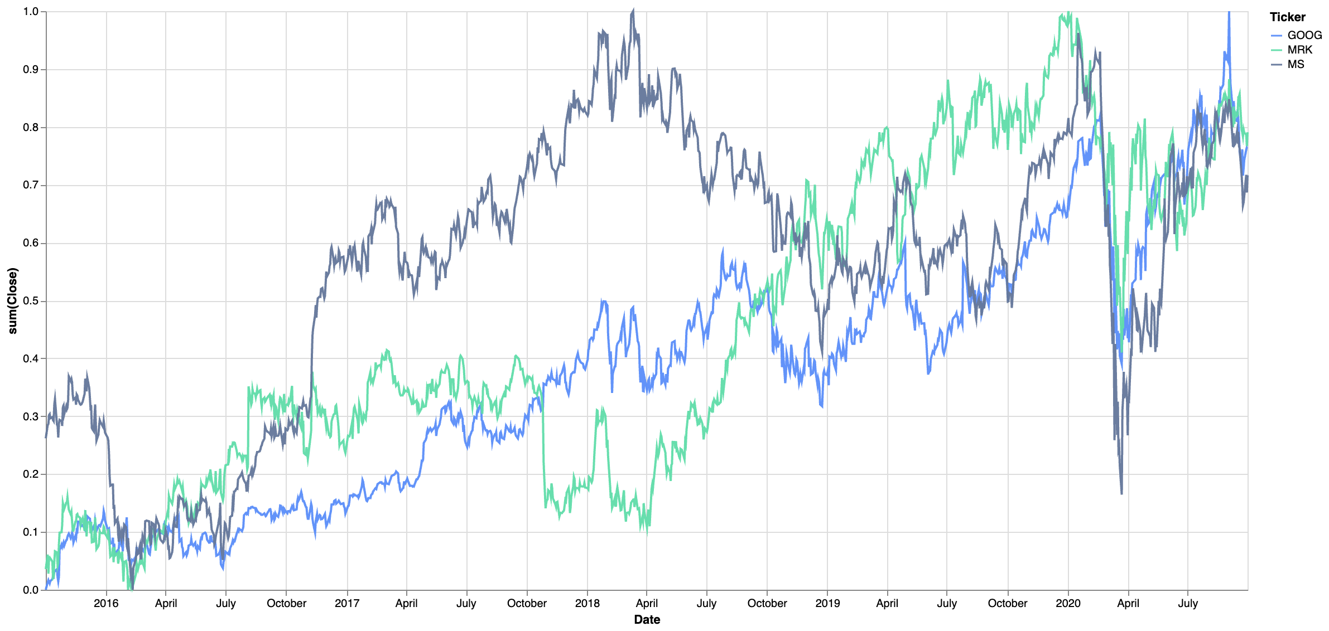
Stocks Performance (normalized data) - II
With normalized data – Google, Merck and Co Inc. & Morgan Stanley have shown above 50% performance in the last 5 years.

Slide 11
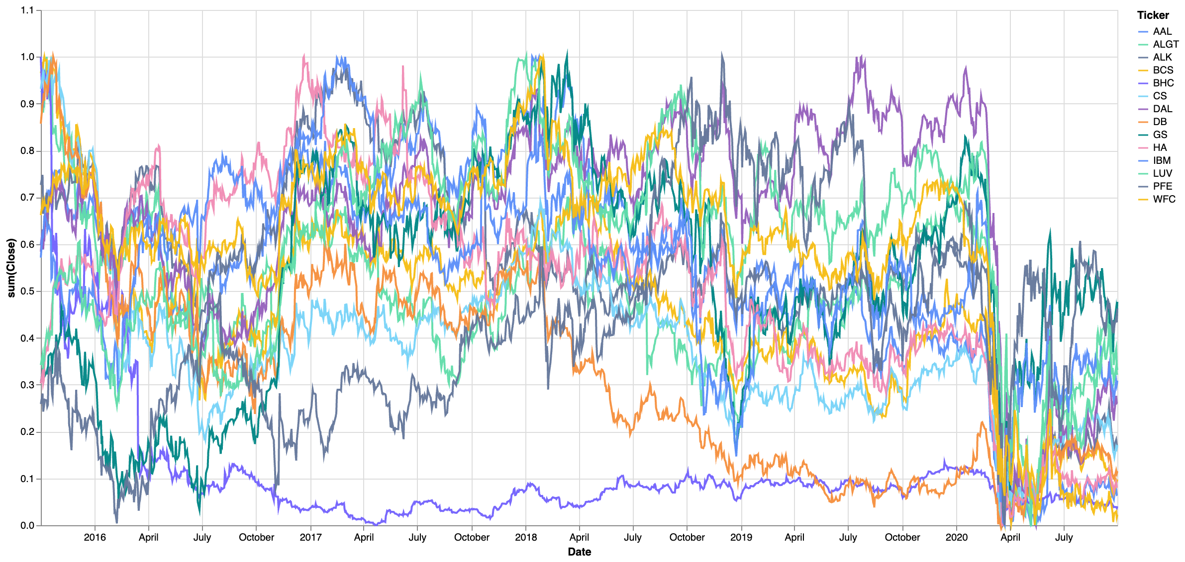
Stocks Performance (normalized data) - III
Aviation Industry, Barclays, Bausch Health Companies, Credit Suisse, Deutsche Bank, Goldman Sachs, IBM, Pfizer and Wells Fargo have shown below 50% performance.

Slide 12
Sector-wise Analysis

Slide 13
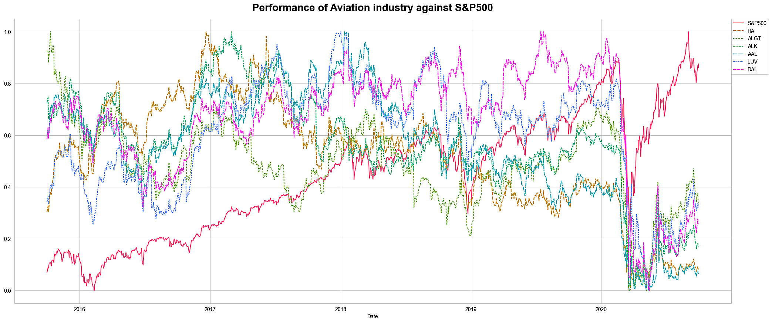
Aviation
This sector suffered a severe decline in March 2020 due to COVID-19 and has not yet recovered, with ongoing challenges persisting despite an improving overall market.

Slide 14
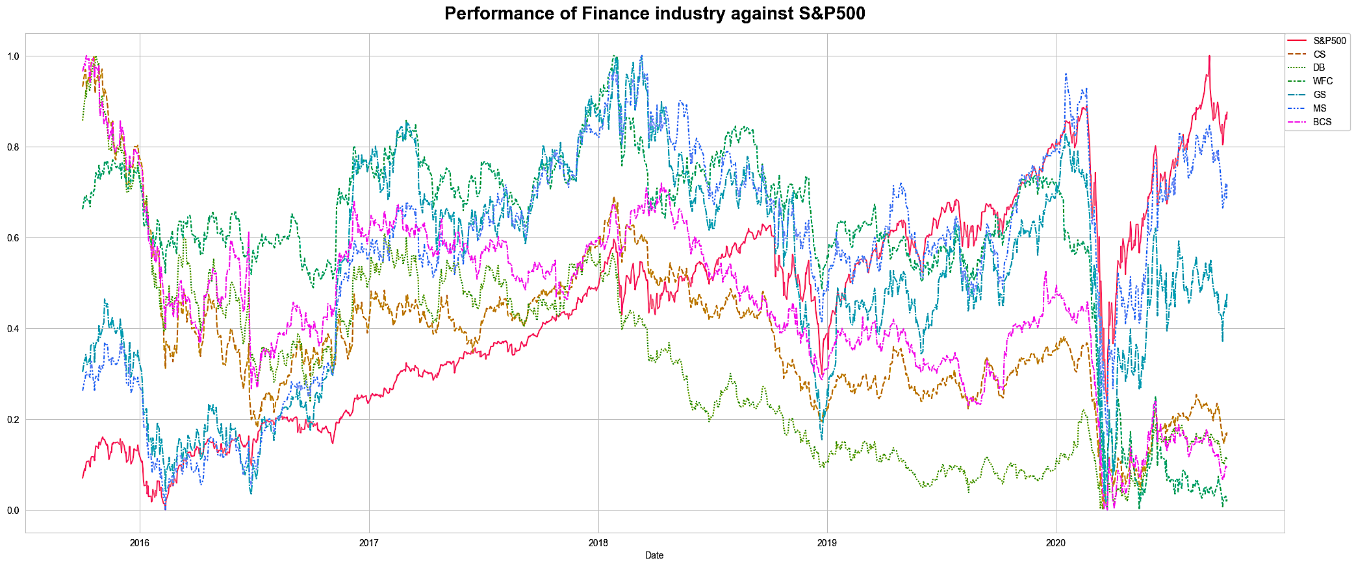
Finance
This sector was also impacted by COVID-19, but while many stocks struggled to recover, Morgan Stanley and Goldman Sachs stood out as relative performers.

Slide 15
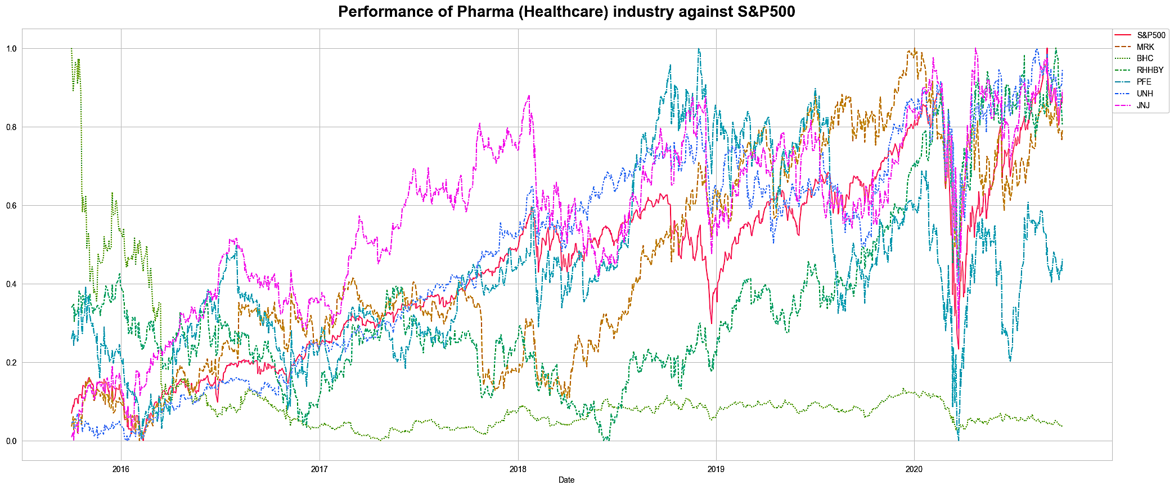
Pharmaceuticals / Healthcare
The pandemic also impacted this sector, but UnitedHealth and Johnson & Johnson have since outperformed the S&P Index, while Bausch Health has underperformed.

Slide 16
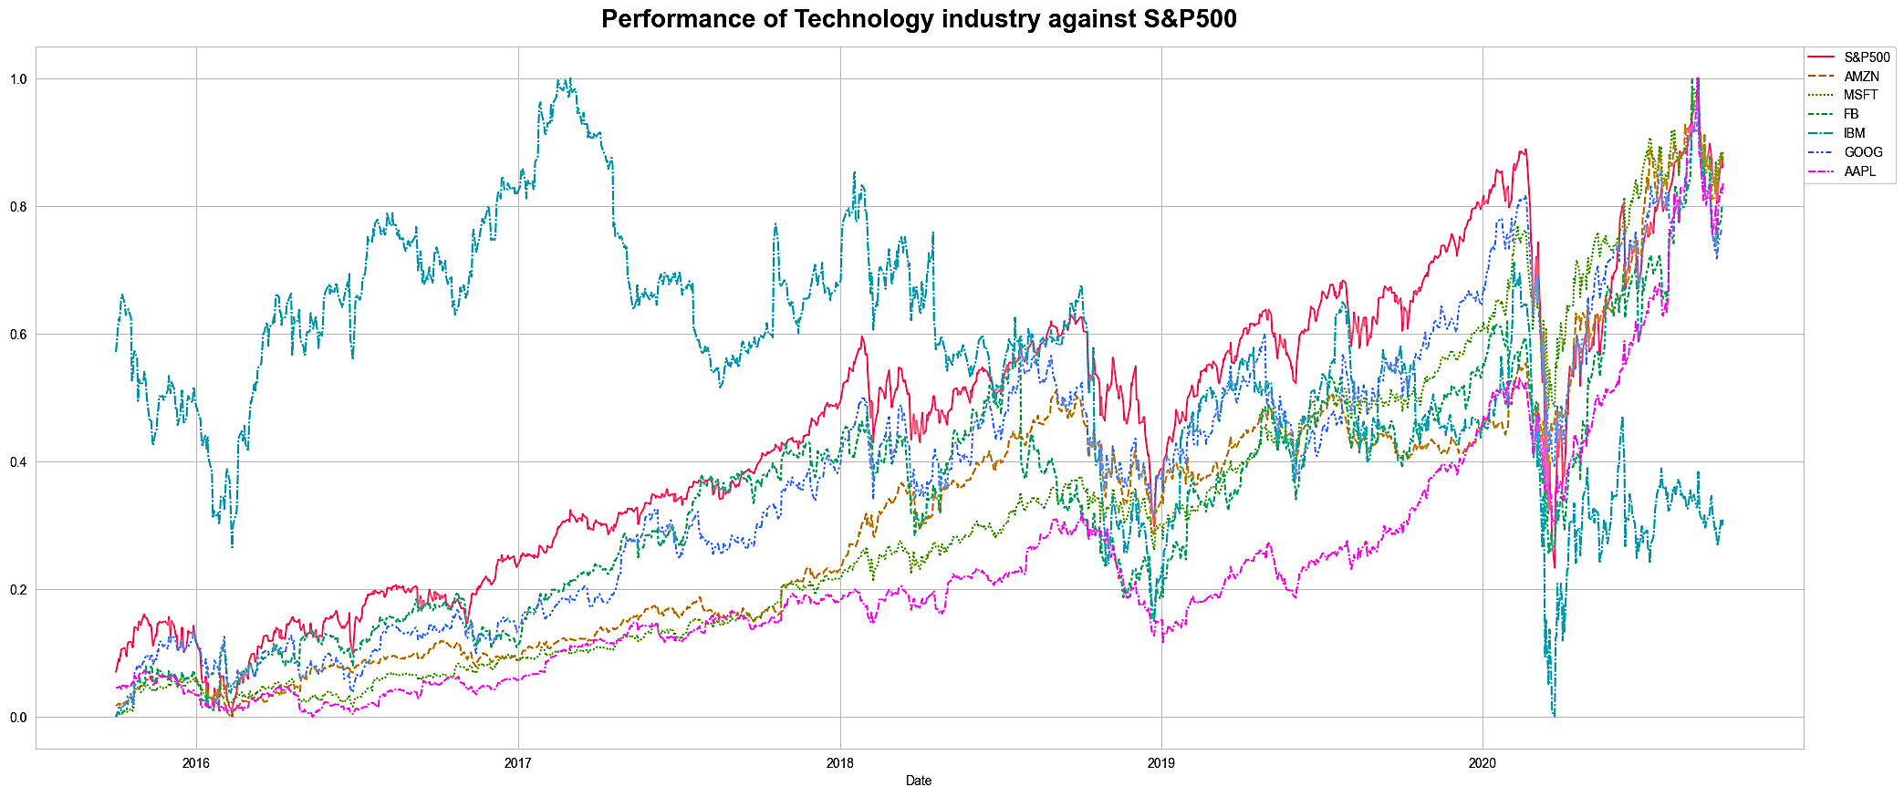
Technology
The sector has shown a commendable recovery, with Microsoft, Amazon, Apple, Facebook, and Google not only rebounding but also outperforming the market index.

Slide 17
Key Findings

Slide 18
Annual Returns
Top Stocks with High Annual Returns
AMZN: 40.59%
MSFT: 34.95%
AAPL: 33.32%
FB: 26.45%
UNH: 23.72%
GOOG: 21.02%
MS: 14.55%
Ticker | Avg. Daily Returns | Risk | Min | Max | Annualized Returns | Annualized Risk | Sharpe Ratio | Cumulative Returns
AMZN | 0.16 | 1.9 | -7.92 | 13.22 | 40.59 | 30.11 | 1.32 | 504.69
MSFT | 0.14 | 1.75 | -14.74 | 14.22 | 34.95 | 27.84 | 1.23 | 371.49
AAPL | 0.13 | 1.87 | -12.86 | 11.98 | 33.32 | 29.73 | 1.1 | 322.74
FB | 0.1 | 2.04 | -18.96 | 15.52 | 26.45 | 32.31 | 0.8 | 187.96
UNH | 0.09 | 1.78 | -17.28 | 12.8 | 23.72 | 28.27 | 0.81 | 167.36
GOOG | 0.08 | 1.65 | -11.1 | 10.45 | 21.02 | 26.23 | 0.77 | 140.41
MS | 0.06 | 2.18 | -15.6 | 19.77 | 14.55 | 34.62 | 0.4 | 53.49
S&P500 | 0.05 | 1.21 | -11.98 | 9.38 | 13.04 | 19.18 | 0.64 | 74.81
MRK | 0.05 | 1.41 | -8.9 | 10.41 | 12.88 | 22.33 | 0.54 | 68.02
JNJ | 0.05 | 1.25 | -10.04 | 8.0 | 11.35 | 19.78 | 0.54 | 59.79
GS | 0.03 | 1.99 | -12.71 | 17.58 | 7.64 | 31.59 | 0.22 | 14.17
RHHBY | 0.03 | 1.35 | -8.96 | 13.01 | 7.38 | 21.45 | 0.31 | 28.87
LUV | 0.02 | 2.29 | -15.11 | 14.44 | 6.16 | 36.37 | 0.15 | -2.37
PFE | 0.02 | 1.38 | -7.73 | 8.96 | 5.25 | 21.95 | 0.21 | 15.26
DAL | 0.0 | 2.65 | -25.99 | 21.02 | 1.05 | 42.03 | 0.01 | -32.66
HA | 0.0 | 3.31 | -26.5 | 24.58 | 0.86 | 52.6 | 0.0 | -47.88
IBM | 0.0 | 1.61 | -12.85 | 11.3 | -0.04 | 25.54 | -0.03 | -15.27
ALGT | 0.0 | 2.91 | -28.33 | 29.24 | -1.19 | 46.2 | -0.04 | -45.04
ALK | -0.03 | 2.69 | -23.24 | 20.31 | -6.44 | 42.71 | -0.17 | -54.34
AAL | -0.03 | 3.47 | -25.22 | 41.1 | -8.47 | 55.12 | -0.17 | -68.65
WFC | -0.04 | 2.03 | -15.87 | 14.53 | -10.44 | 32.3 | -0.35 | -54.3
CS | -0.04 | 2.28 | -18.26 | 16.34 | -11.01 | 36.26 | -0.32 | -58.61
DB | -0.05 | 2.77 | -17.49 | 14.02 | -13.33 | 44.04 | -0.32 | -68.33
BCS | -0.05 | 2.51 | -21.85 | 15.1 | -13.82 | 39.87 | -0.37 | -66.62
BHC | -0.09 | 4.46 | -51.46 | 33.74 | -22.6 | 70.72 | -0.33 | -91.35

Slide 19
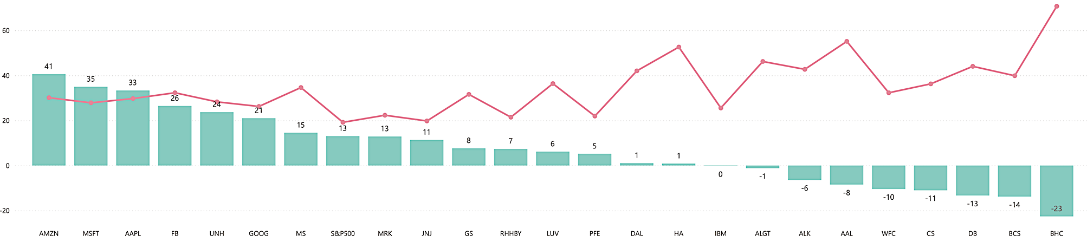
Annualized Risk & Returns
The top five performing stocks by annualized return are Amazon (AMZN), Microsoft (MSFT), Apple (AAPL), Facebook (FB), and UnitedHealth Group (UNH).
Each of these top 5 stocks has an annualized return exceeding 20%, and their risk profile is considered moderate compared to other equities.
Conversely, lower returns increase the likelihood of losing initial investment capital.
The five banks - Bank of America (BHC), Bank of Canada (BCS), Deutsche Bank (DB), Credit Suisse (CS), and Wells Fargo (WFC) - are characterized by higher risk as they did not generate sufficient returns to compensate for the initial investment.
A lower return on investment (ROI) often indicates a higher level of risk in stocks. Nevertheless, some equities may offer stable returns at relatively low risk, providing investors with a safer opportunity.
Johnson & Johnson (JNJ), Roche Holding (RHHBY), and Merck & Co. (MRK) are notable examples of stocks that balance risk and return, offering more conservative investment options.

Slide 20
Portfolio Analysis

Slide 21
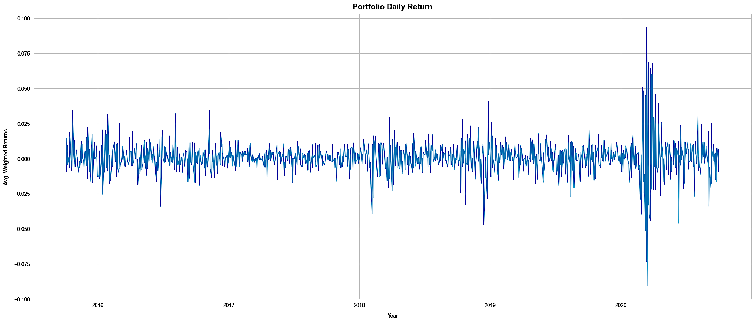
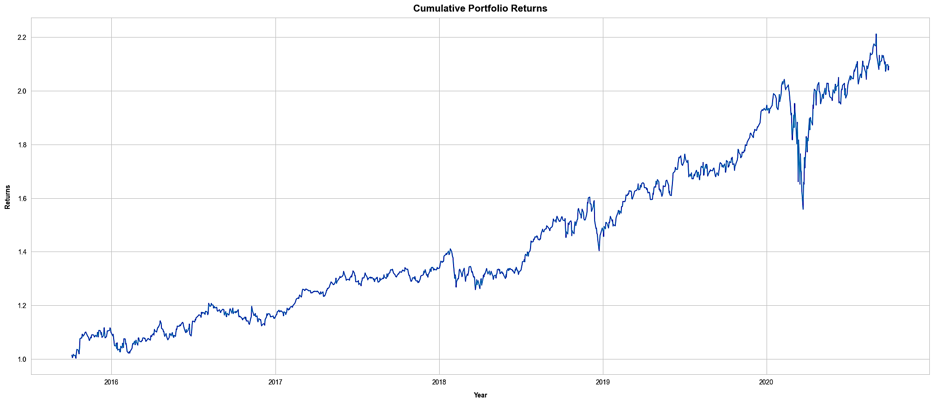
Patrick Jyengar’s Portfolio
Investment Objective
Mr. Patrick aims to double his investment over a period of 5 years.
He seeks to invest in low-risk stocks that generate decent returns.
Stock Selection
Based on his profile, suitable low-risk stocks for investment include:
Johnson & Johnson (JNJ)
Roche Holding AG (RHHBY)
Merck & Co., Inc. (MRK)
Portfolio Composition
To achieve the desired returns, a portion of Mr. Patrick’s wealth will be invested in Microsoft Corporation (MSFT).
The portfolio will consist of equal weightages of 0.25 for each stock
Investment Amount and Expected Returns
Mr. Patrick will invest $500,000 in the above-mentioned portfolio.
After 5 years, the expected returns on his investment would be approximately $1.05 M resulting in a gain of $558 K.

Slide 22
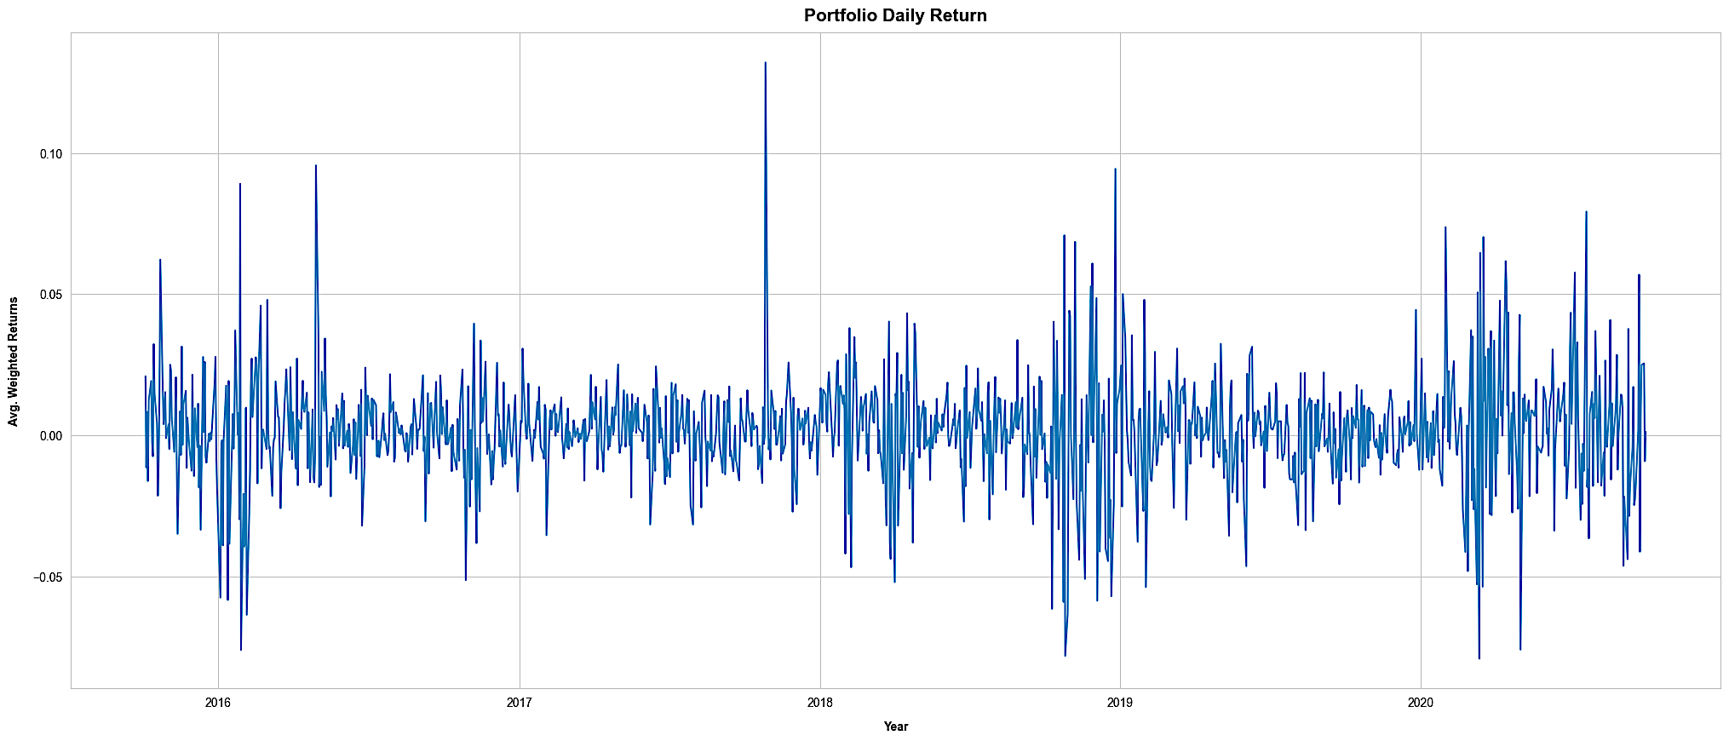
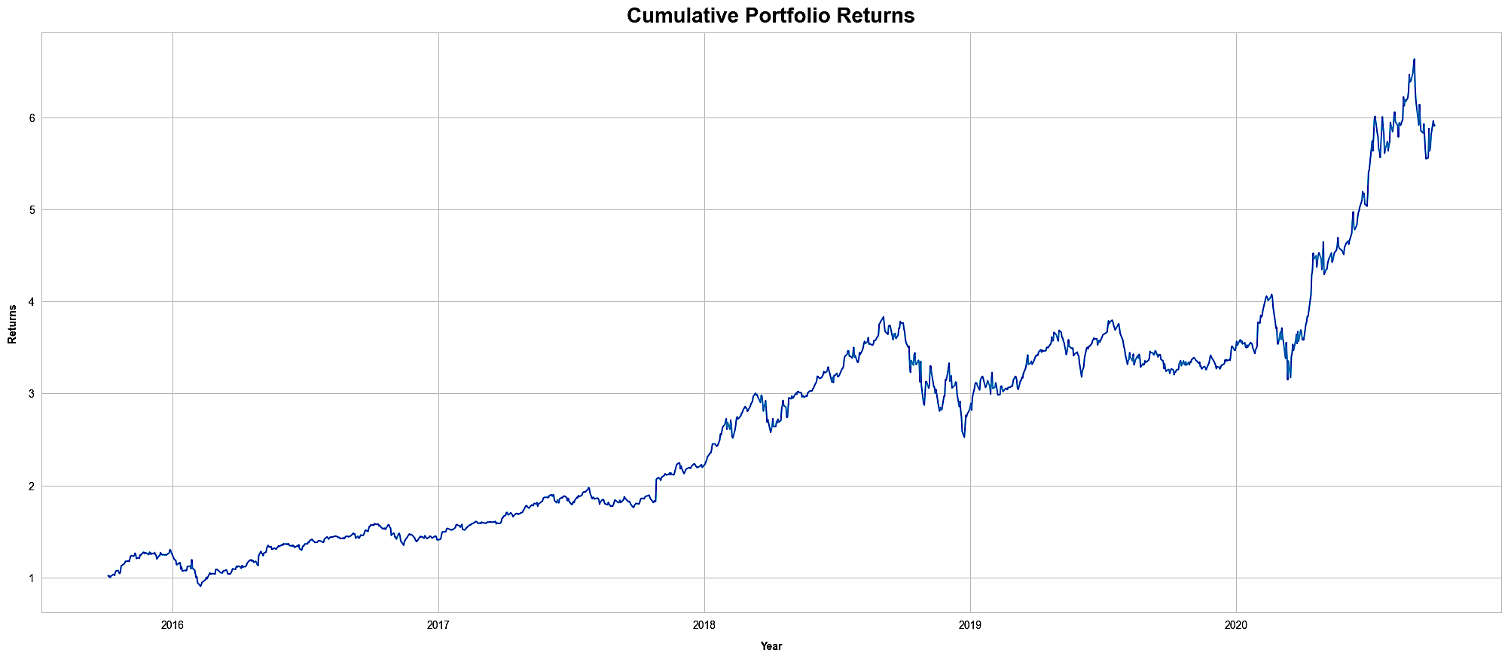
Peter Jyengar’s Portfolio
Investment Objective
Mr. Peter Jyengar seeks high-return investments, consistent with his risk-taking attitude.
He believes that occasional losses can be mitigated by bouncing back and expects significant returns for inorganic expansion of his company.
Portfolio Composition
Mr. Jyengar aims to invest $1 million from the company's cash and cash equivalents in a single high-margin stock.
Based on his profile, a suitable high-risk/high-return stock for investment is Amazon Inc. (AMZN).
Investment Amount and Expected Returns
Mr. Peter will invest $1 million in the AMZN stock.
After 5 years, the expected returns on his investment would be approximately $6 million, resulting in a gain of over $5 million.
Note: The high-risk/high-return nature of this portfolio is designed to cater to Mr. Peter's risk tolerance and provide maximum returns for his company's expansion.

Slide 23

Methodology

Slide 24
Methodology
Step 1 | Load Libraries and Data
Step 2 | Exploratory Data Analysis (EDA)
Step 3 | Data Analysis
Imported required libraries in python required for data analysis, manipulation and visualization.
Checked for null values. About 0.2% of the rows had no data in it, and hence were dropped. Examined the dataset for outliers.
Calculated Daily returns, Cumulative returns, Sharpe ratio, Portfolio risk, and ROI. Identified the top-performing stocks. Discovered stocks with over 80% returns in the last five years.
Imported CSV files with stocks data segregated based on Industry/Sectors.
Step 4 | Stock selection
Performed sector-wise analysis to get a better view of each sector.
Each stock possesses unique characteristics, including varying levels of risk and liability. Amazon (AMZN) is notable for its potential to generate high returns, although this comes at a higher level of risk. In contrast, stocks such as Johnson & Johnson (JNJ), Roche Holding (RHHBY), Merck & Co. (MRK), and Microsoft (MSFT) offer good returns while presenting lower levels of risk.
Step 5 | Portfolio creation
Finalized portfolios for Mr. Patrick and Peter Jyengar based on the analysis and requirements.

Slide 25
THANK YOU.

